Slide 1
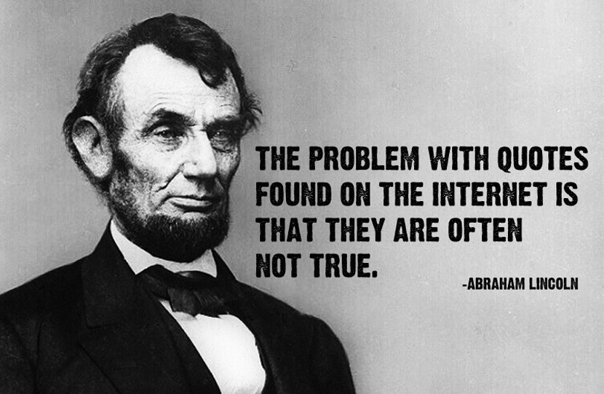
Evaluating websites
Is this site any good or is it just crap?

Slide 2
Short video clips:
Evaluating Websites 1:57
Evaluating Websites with Mrs. Thompson 3:01
Evaluating Websites with the 5 Ws

Slide 3
Anyone can post anything on the Internet…
Without it ever being fact-checked or edited!
How do I know if the site is worth using?
--or—
Am I wasting my time?
There are a few things you should take into consideration to help you decide…

Slide 4
1. Professionalism
Does the site look professional?
Does the language sound serious & credible?
Does the site use correct grammar & spelling?
Is there a balance of text & images? (instead of being mostly images)
If the site doesn’t look credible, odds are it isn’t.

Slide 5
2. Authority/expertise
*Does this person even know what they’re talking about?*
"About us” Section--Information given about the author: Name & Contact Info? Background? Qualifications/Credentials? Awards?
Think about accountability, validity, legitimacy, reliability, reputation, etc.
Preferred domain—Look at the url. Is it a .gov, .edu, or .org-hosted site? (*.com isn't always bad…If it’s a .com.co, be suspicious.)
Look for quotes—Who is quoted? Is that person an expert? Do they at least know what they’re talking about?

Slide 6
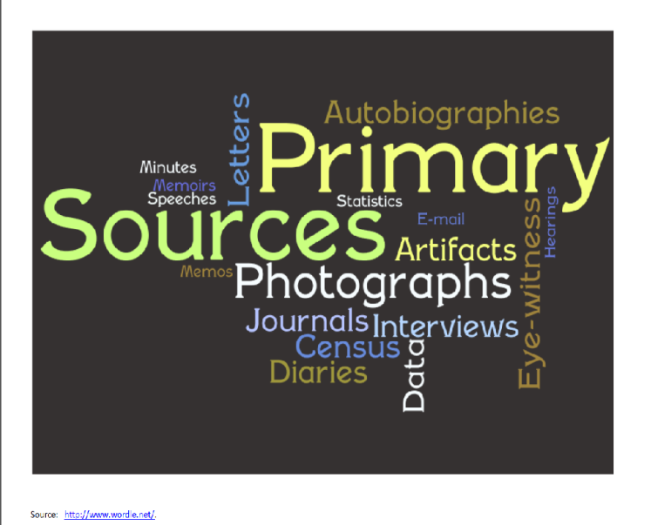
3. Accuracy/integrity
Is the site written for informational/educational purposes?
Are there valuable links to other sites?
Is there a Bibliography/Works Cited so you can check (cross-reference) the information?
Does the page contain primary source material (original sources, first hand accounts, of information)?

Slide 7
4. relevance
Does the info fit your purpose?
Does the title clearly match the contents?
Are there valuable links to other sites?
Do those links make sense & match the contents?
Is the story completely outrageous? Some “news” sites are simply satire (humor, irony, exaggeration, ridicule, mockery, sarcasm) & should be seen as such. They are fun, but not academic. (Examples: The Onion, The Borowitz Report )

Slide 8
5. Currency/timeliness
When was the site created? Is it current? When was it last updated?
Do the links work? (Should be few or no dead links.)
Are the links up-to-date? (This goes hand-in-hand with someone updating it.)

Slide 9
6. Point of view/objectivity
Balanced Viewpoint--Provides both points of view (Info not biased or slanted)
Site should contain more facts that opinion. If opinions are given, they should be in a non-inflammatory, respectful way.
Purpose of site is to inform rather than to persuade.
Limited advertising--Make sure the page isn't just trying to sell you something.
*Diversify your sources—One way to make sure you are objective is to look at more than one news source. *

Slide 11
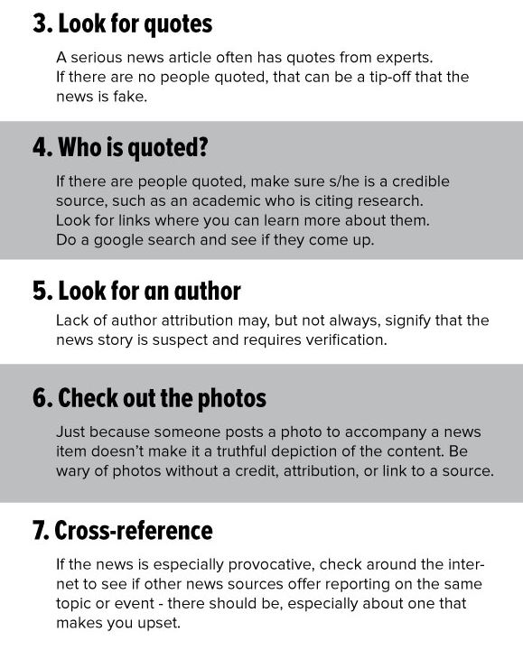
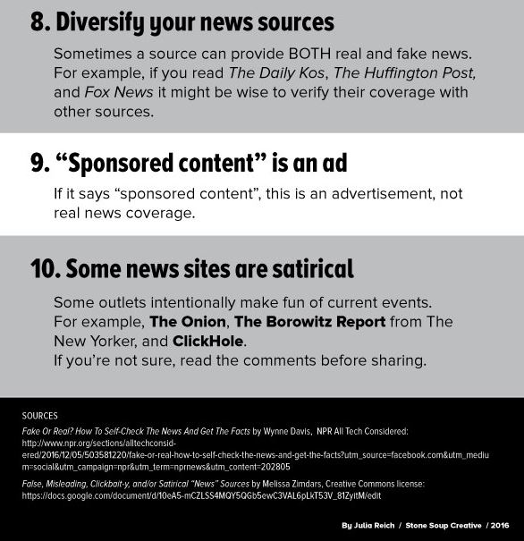

Slide 12
Helpful websites
Teaching Digital Literacy & Combatting Fake News
How to Evaluate Information (with Checklist)
How to Spot Fake News/Propaganda (Lesson Plan)

Slide 13
How savvy are your students?
7 Fake Web Sites to Really Test Their Evaluation Skills:
Websites to test evaluation skills

Slide 14
bibliography
Kirschenbaum, Michele. "Evaluating a News Article." EasyBib (2016).
Kapoun, Jim. "Teaching undergrads WEB evaluation: A guide for library instruction." C&RL News (July/August 1998): 522-523.

